Slide 1
Product Identification and Traceability
Roles and Responsibilities throughout {Small Manufacturing Company}
Notes:
In this training presentation, we will be defining and exploring what product identification and traceability is and why {Small Manufacturing Company} uses this process to keep track of the manufacturing of our products from customer purchase order to making the product to shipping the completed package to our customers. Traceability is a crucial process in all manufacturing to ensure that materials are made correctly, in the right quality and quantity to meet customer needs. To engage in traceability, we first need to know what products we make and how to distinguished one product from another. Throughout this presentation ask yourself, how can I help make sure that the products we make are well made, meet customer needs, and are shipped on time.

Slide 2
Keeping Track of our Product
Receiving Process
Role of Quality Assurance
Engineering
Manufacturing
Notes:
Throughout our training presentation, we will be addressing the topics listed here.

Slide 3
Explain how products are identified at {Small Manufacturing Company}.
Define the traceability process at {Small Manufacturing Company}.
Identify your role in the traceability process.
Notes:
Throughout this training presentation we will work together to achieve the following learning objectives:
Explain how products are identified at {Small Manufacturing Company}.
Define the traceability process at {Small Manufacturing Company}.
Identify your role in the traceability process.

Slide 4
Product Identification

Slide 5
Try It!
Identify the different types of gears exercise.
Notes:
Facilitator provide the trainees different examples of the gears made by {Small Manufacturing Company} and show them the similarities and differences between them. What are characteristics you want them to be able to identify or recognize? What documents do they need to be able to identify?

Slide 6

Precision Gears
Complex, tight tolerance gearing
Complex shapes, alloys and sizes
Manufacturing process configured to efficiently produce, even in small lot sizes
Measure down to the 0.0001” – sometimes even tighter than that.
Serve defense, automotive and commercial markets.
Quality, Quality, Quality
Notes:
At {Small Manufacturing Company} we produce two main products: precision gears and gearbox assemblies. The first step in product identification and traceability is to be able to identify the products. Precision Gears are
Complex, tight tolerance gearing
Complex shapes, alloys and sizes
Manufacturing process configured to efficiently produce, even in small lot sizes
We currently serve defense, automotive and commercial markets.
We measure down to the 0.0001” – sometimes even tighter than that.
Quality is our number one focus.
We do this through thorough inspection and state-of-the-art equipment.

Slide 7
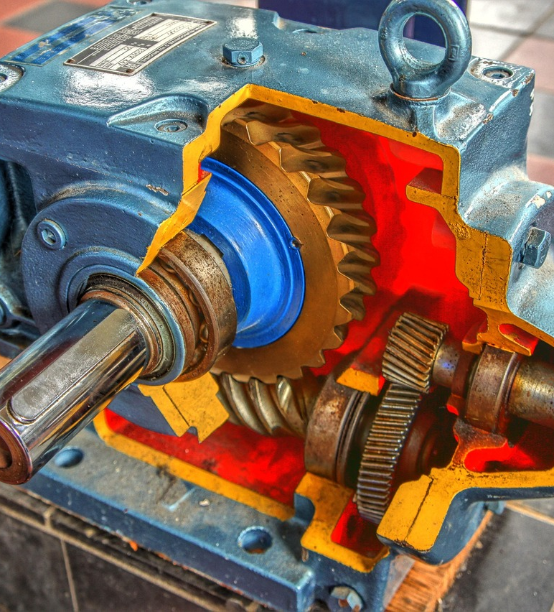
Gearbox Assemblies
Manufactured to exact customer specifications
Quality is maintained by :
work instructions,
torque device calibration,
cleanliness, and
training for assembly specific tasks.
Notes:
Gearbox assemblies are manufactured to exact customer specifications. All gearbox assemblies and gears are maintained by work instructions, torque device calibration, cleanliness, and training for assembly specific tasks.

Slide 8
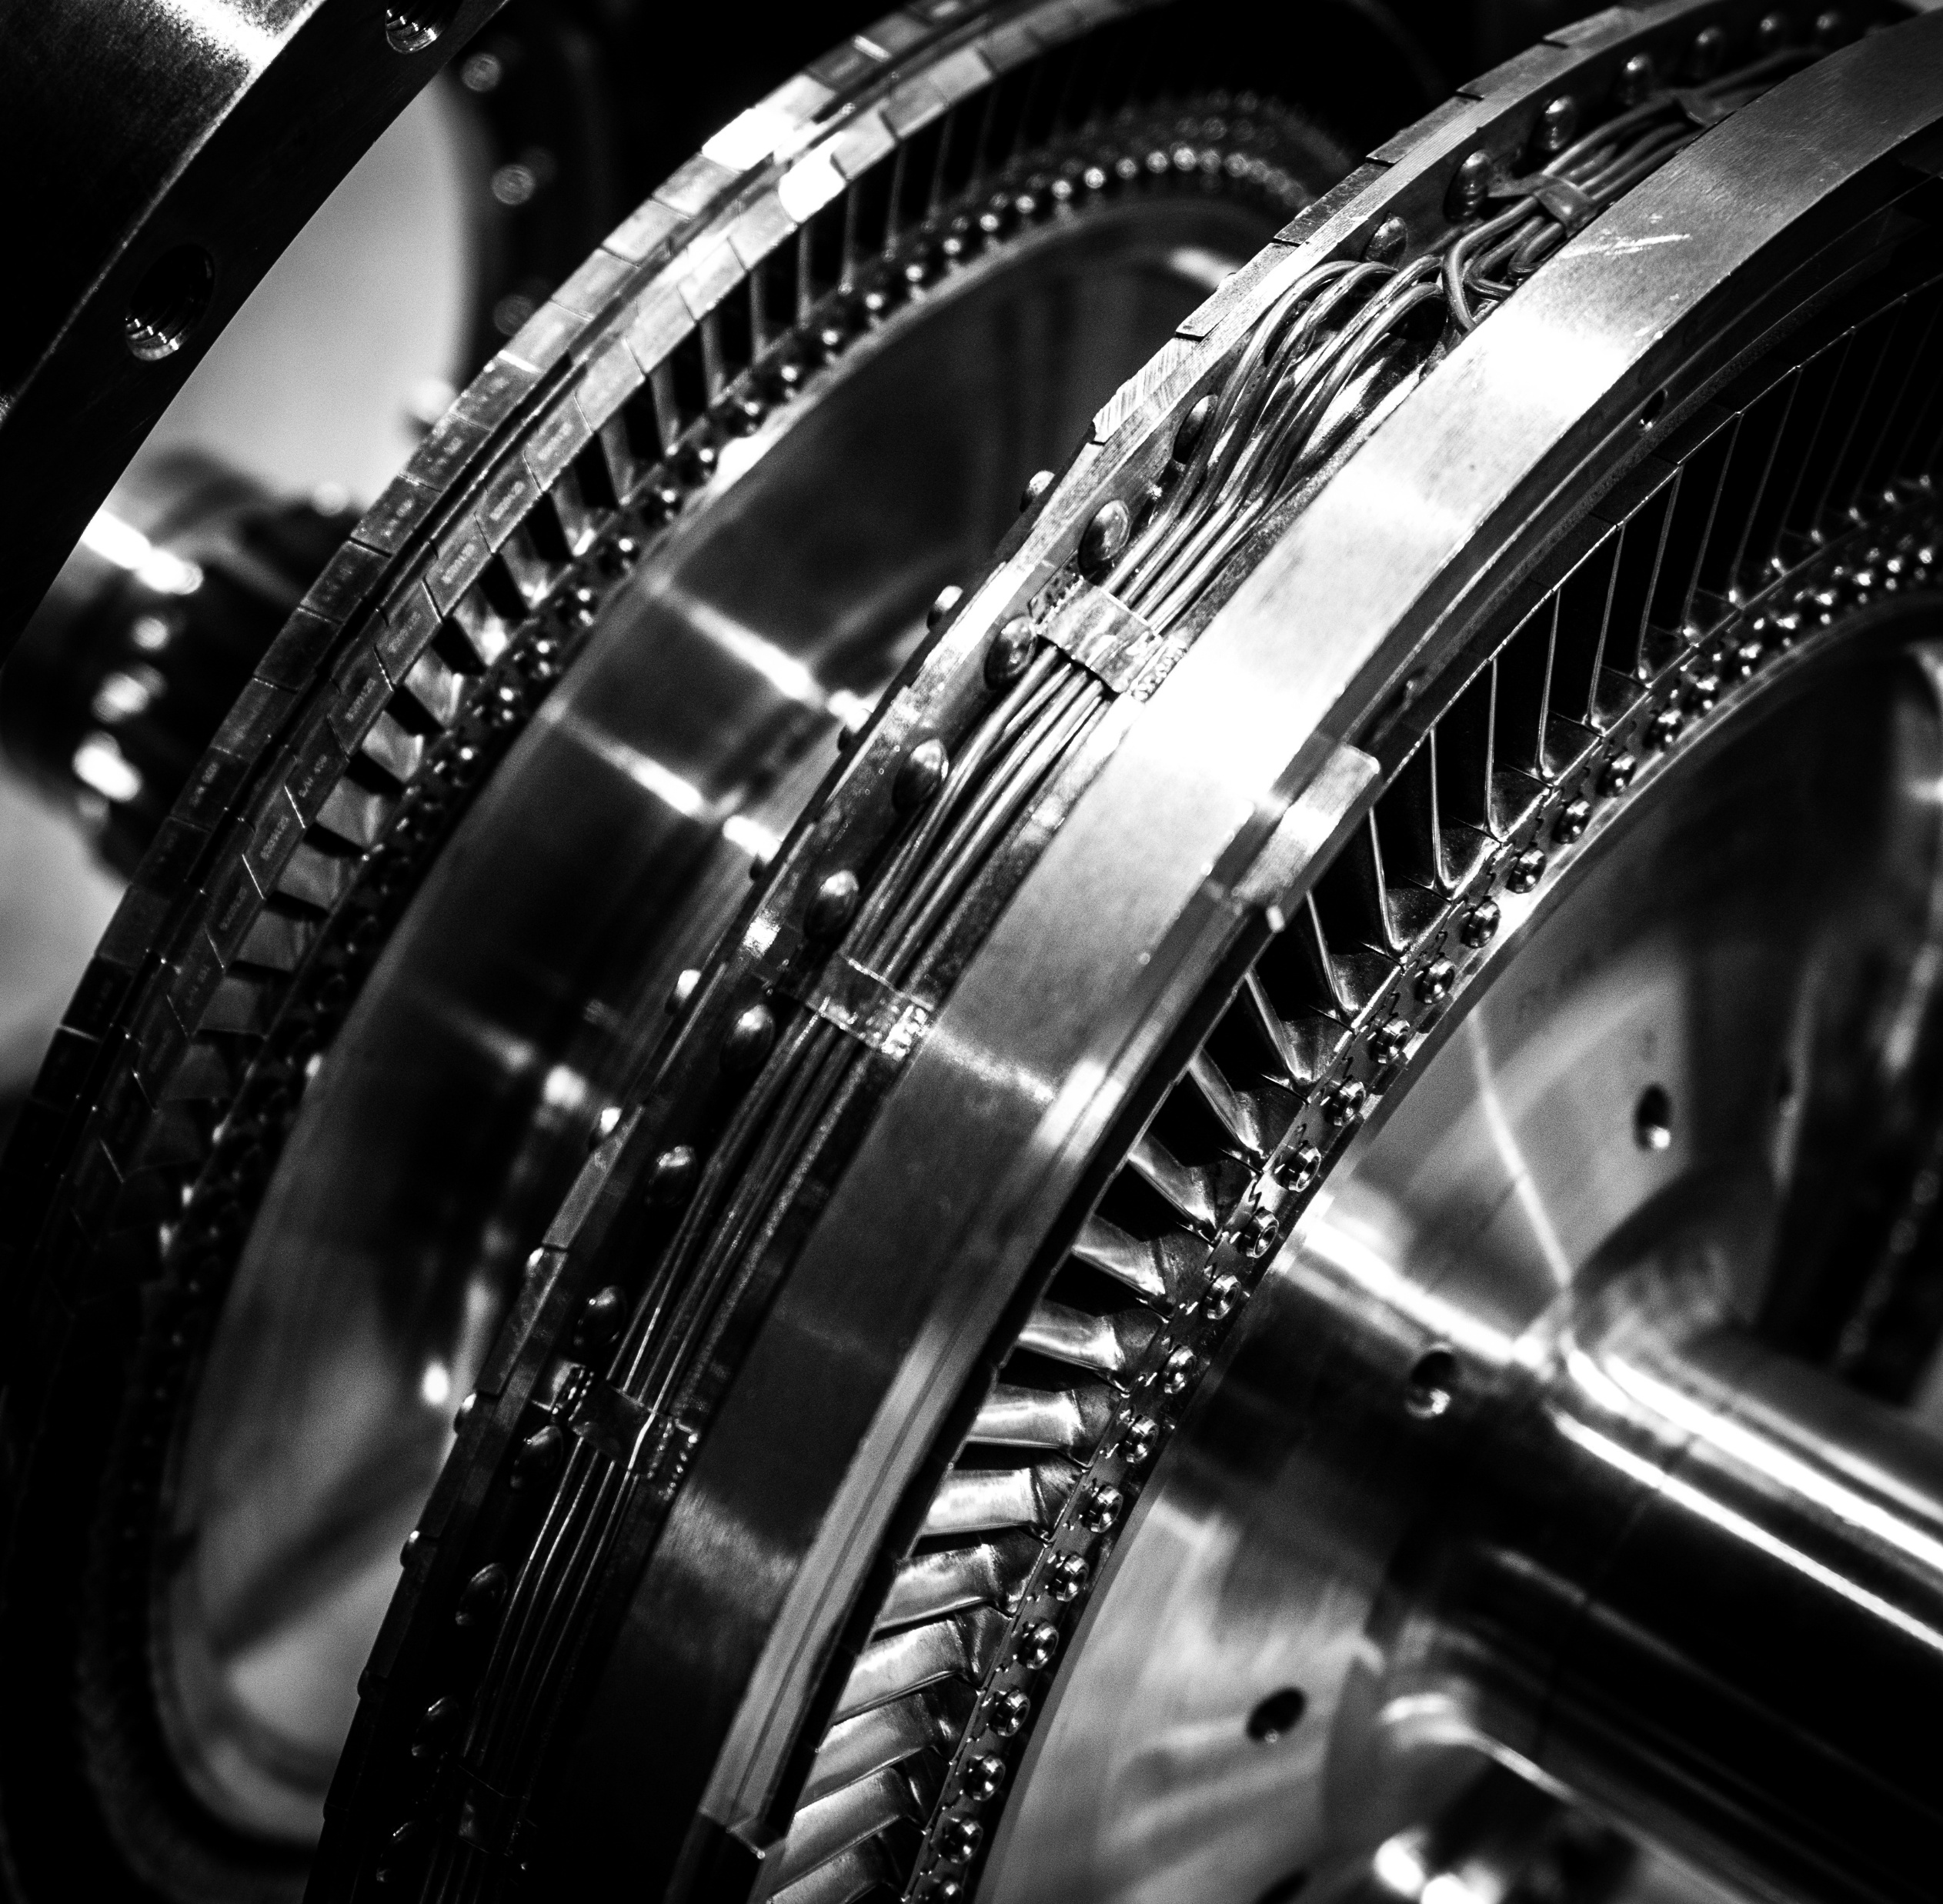
Subcontractor Materials
Customer Requirements
Raw Materials
  Quality
  Quantity
Notes:
Once a customer makes their purchase order, raw materials are ordered from subcontractors. These materials need to meet customer requirements and customers often order the materials and send them to us themselves. Once we receive the subcontractor materials, we need to make sure we received the correct number of materials and that they are good quality materials. Our gears can not be great if the materials they are made from are not. Customer requested gaging and tooling should also be clearly marked. We want to document the condition of any customer supplied material upon receipt of it.

Slide 9
Be On the Look Out
Broken parts
Missing components
Non-conformance to PO
Incomplete outside operation.
Notes:
Throughout the manufacturing process, be on the look out for broken parts, missing components, non-conformance to PO, and any incomplete outside operation. These issues need to be identified and rectified quickly to maintain quality and meet customer requirements.

Slide 10
Product Traceability

Slide 11
Product Traceability
Customer Requirements
Raw Materials
Product Production
Notes:
All of our products are customized to our customers specifications. Because each gear and gearbox assembly are unique to the customer, we have to be extremely careful about keeping track of every product throughout the production process. Starting when we receive our customer’s specifications and directions for how they want a product, through the manufacturing process until we ship the product to the customer, we have to maintain consistent labeling and monitor the process closely to ensure that our customers receive exactly what they ordered, quality gears.

Slide 12
Traceability
Receiving
Purchase Order
Quality
Quality Assurance
Mill Certification
Engineering
Shop Traveler
Manufacturing
Quantity
Signature Quality Log
Signature Quality Log Sheet
Serial Number Log Sheet
Notes:
Throughout the manufacturing process, we have to keep track of what products we are making and how they are made, so we can track what items we are producing for which customers. Without this process, materials can be lost, products can be produced incorrectly, and costly mistakes can be made. At each step in the process, everyone has specific responsibilities to ensure that our customers receive the quality materials they have requested.
Receiving:
Quality Assurance:
Engineering:
Manufacturing:

Slide 13
Customer
Identify examples of raw materials from customers.
Review a Shop Traveler and Mill Certificate
Locate relevant information for your position.
Notes:
Facilitator: During training, provide trainees an example of order work papers, such as shop traveler, mill certificate, and other specifications. Have participants look for specific information on the sheets.
What might these materials consist of?
This mostly refers to raw material bought by the customer.
This can also include gaging or tooling.
What should employees be looking for in terms of quality and any other identifiers?

