Slide 1

The Art of Persuasion
Speaking to Your Audience
Notes:
Julie, Brad, and I have been working together to create a series on engaging presentations.

Slide 2

T.R.A.I.N
CONNECTING WITH AUDIENCES AND PRESENTING IDEAS
Teach Reach Adapt Inspire Nurture
Tip: Use links to go to a different page inside your presentation.
How: Highlight text, click on the link symbol on the toolbar, and select the page in your presentation you want to connect.

Slide 3

Presenter
DR. JULIA SMITH
Anthology- Educational Consultant Instructor - 15+ years University of Illinois, Urbana - Champaign, English with a specialization in Writing Studies
Tip: Use links to go to a different page inside your presentation.
How: Highlight text, click on the link symbol on the toolbar, and select the page in your presentation you want to connect.

Slide 4

Agenda
CONNECTING WITH AUDIENCES AND PRESENTING IDEAS
Rhetoric Speaker Message Audience Context/Purpose
Tip: Use links to go to a different page inside your presentation.
How: Highlight text, click on the link symbol on the toolbar, and select the page in your presentation you want to connect.

Slide 5

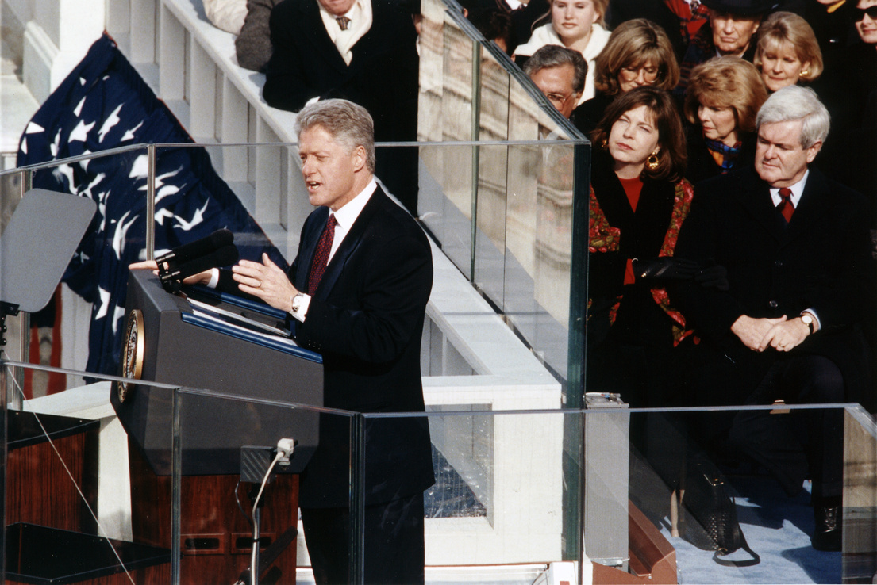
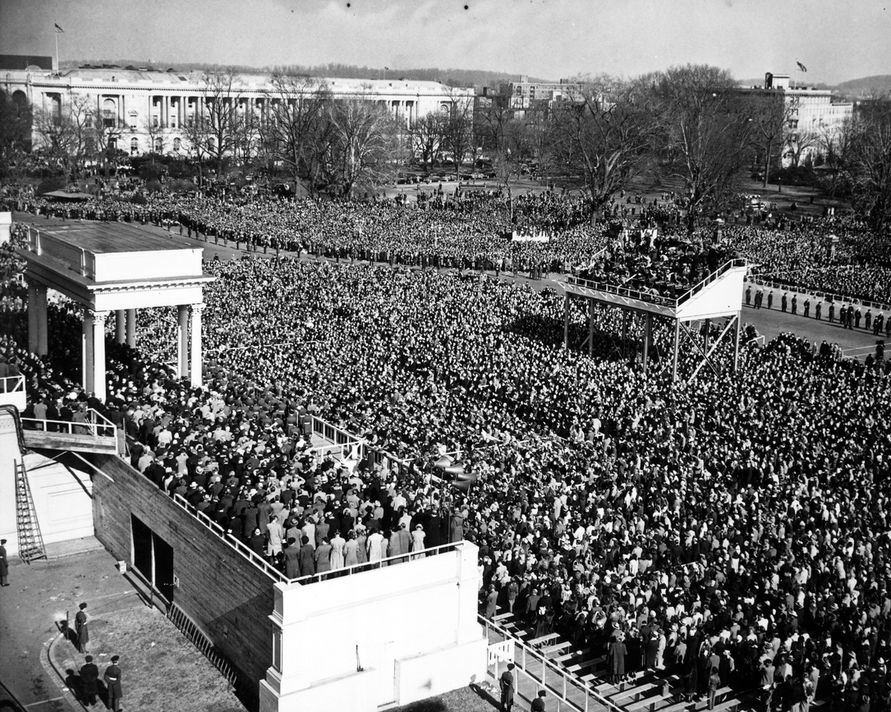
Rhetoric
WHAT IS IT?

Slide 6
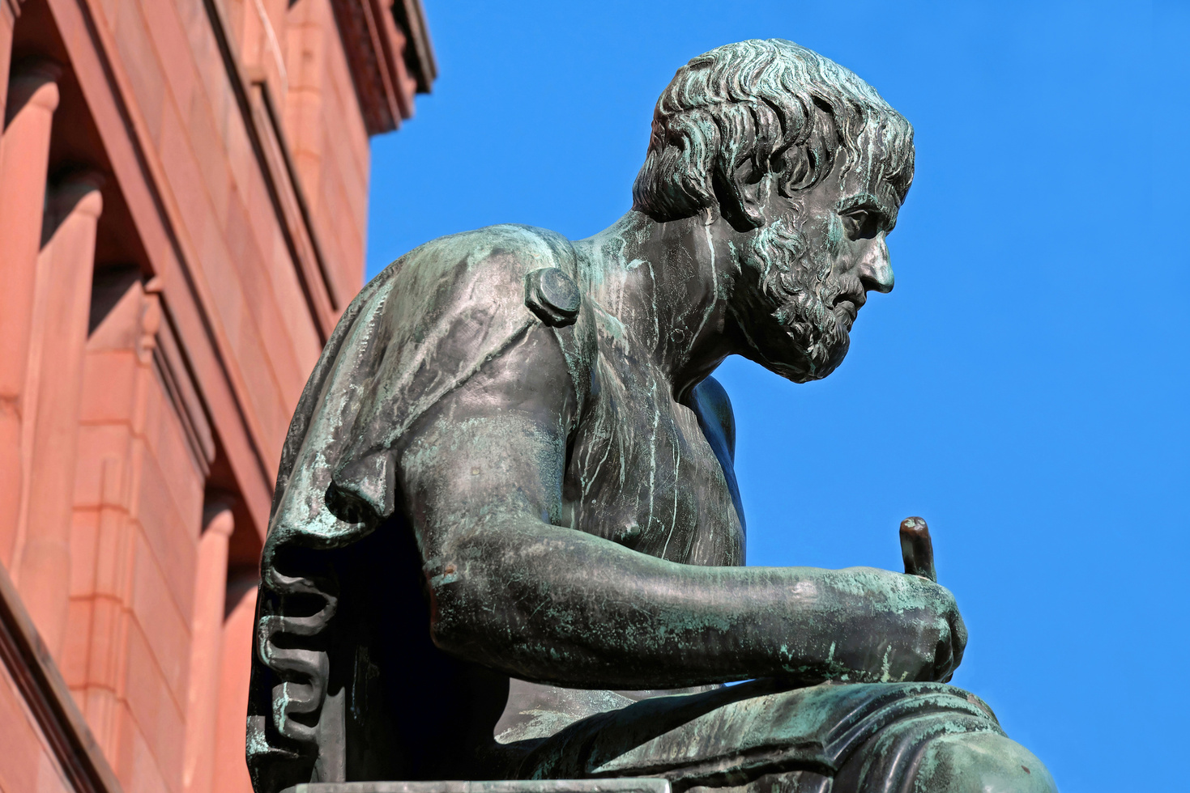
The Art of Persuasion
Rhetoric is meant to
Delight
Move
Teach

Slide 7


Slide 8
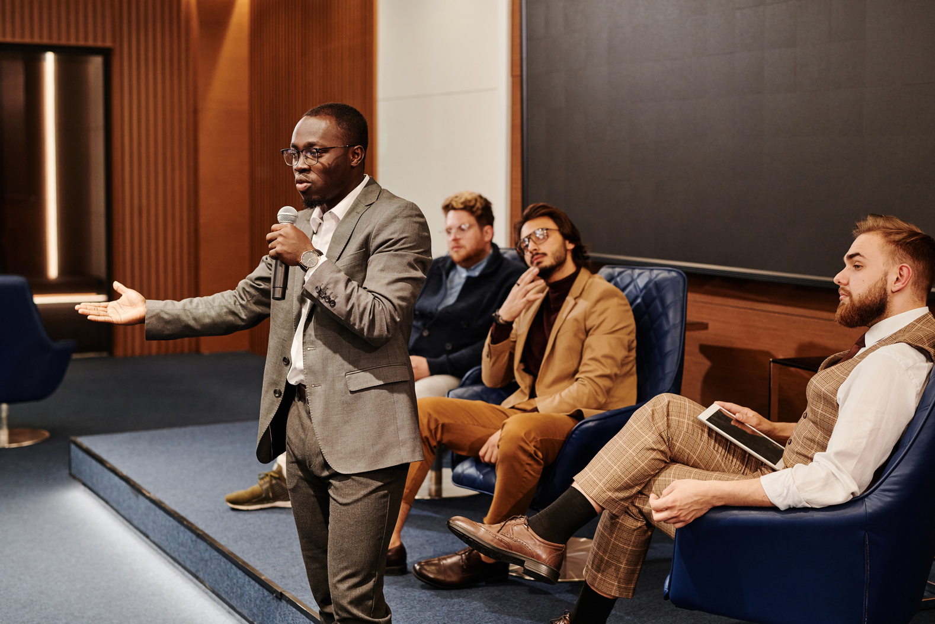

Message
Speaker
Audience

Slide 9

Speaker Perspective
ETHOS: AUTHORITY
Politics of Location | Authority | Kairos

Slide 10
Speaker Perspective
ETHOS: AUTHORITY
Politics of Location | Authority | Kairos
Age Gender State/Country Region Culture Ethnicity Economic Status Politics

Slide 11
Speaker Perspective
ETHOS: AUTHORITY
Politics of Location | Authority | Kairos

Slide 12
Speaker Perspective
ETHOS: AUTHORITY
Politics of Location | Authority | Kairos
Age Gender State/Country Region Culture Ethnicity Economic Status Politics | Dress Knowledge Moral Character Relevant Experience Sound Reasoning Credible Sources Acknowledge Disagreement Shared Common Ground | Opportune Moment

Slide 13


Message
Speaker
Audience

Slide 14
Arrangement
Organizing the information in a logical and clear manner.
Media/Modality
Media: tools or mechanism for delivery of message. Mode: ways of communicating “textual, visual, aural, gestural, spatial
Design Principles
Design principles make viewing, reading, and engaging with your audience easier. Humans have natural tendencies and we are trained early in life how to ‘read.’
Message
HOW THE MESSAGE AFFECTS PERSUASION

Slide 15


Slide 16

Danger

Slide 17

Message
Speaker
Audience

Slide 18
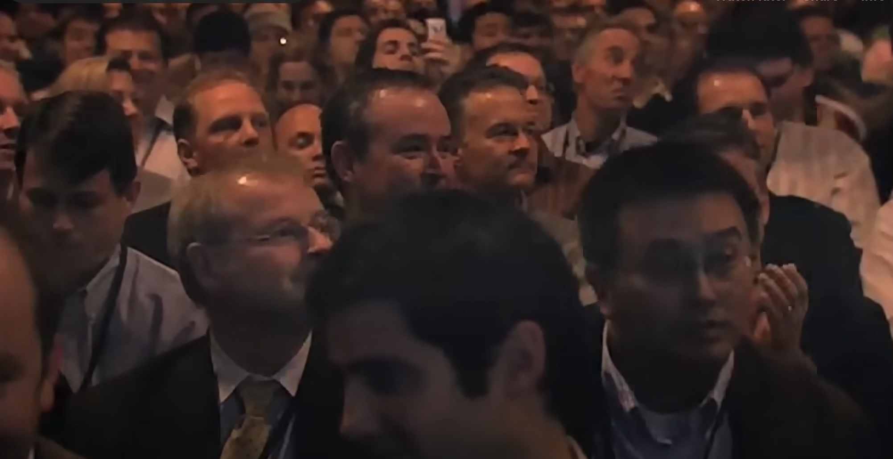

Slide 19
Audience Analysis
1
2
3
4
5
STEP
STEP
STEP
STEP
STEP
Who is your audience?
How might you describe your audience?
What is your topic?
What does your audience want from your presentation?
How will you present your information?
Primary
Secondary
Tertiary
Previous Knowledge
Bias/Assumptions
Experience
History
Demographics
Inference
Delivery
Context
Expectations
Results
Purpose
Expectations
Results

Slide 20


Message
Context
Purpose
Speaker
Audience

Slide 21






How might we apply this to our work?

Slide 22


